Slide 1
AN INTEGRATED RUNTIME AND COMPILE-TIME APPROACH FOR PARALLELIZING STRUCTURED AND BLOCK STRUCTURED APPLICATIONS
Aryaman Mishra

Slide 2
ABSTRACT
Scientific and engineering applications often involve structured meshes. These meshes may be nested (for multigrid codes) and/or irregularly coupled (called multiblock or irregularly coupled regular mesh problems). In this paper, we present a combined runtime and compile-time approach for parallelizing these applications on distributed memory parallel machines in an efficient and machine-independent fashion. We have designed and implemented a runtime library which can be used •o port these applications on distributed memory machines. The library is currently implemented on several different systems. To further ease the task of application programmers, we have developed methods for integrating this runtime library with compilers for HPF-like parallel programming languages. We discuss how we have integrated this runtime library with the Fortran 90D compiler being developed at Syracuse University. We present experimental results to demonstrate the efficacy of our approach. We have experimented with a multiblock Navier-Stokes solver template and a multigrid code. Our experimental results show that our primitives have low runtime communication overheads. Further, the compiler parallelized codes perform within 20% of the code parallelized by manually inserting calls to the runtime libr

Slide 3
Introduction
In recent years, distributed memory parallel machines have been widely recognized as the most likely means of achieving scalable high performance computing. However, there are two major reasons for their lack of popularity among developers of scientific and engineering applications. First, it is very difficult to parallelize application programs on these machines. Second, it is not easy to get good speed-ups and efficiency on communication intensive applications. Current distributed memory machines have good communication bandwidths, but they also have high startup latencies which often result in high communication overheads. Recently there have been major efforts in developing programming language and compiler support for distributed memory machines. Based on the initial works of projects like Fortran D and Vienna Fortran, the High Performance Fortran Forum has recently proposed the first version of High Performance Fortran (HPF) .HPF allows programmer to specify the layout of distributed data and specify parallelism through operations on array sections and through parallel loops. Proposed HPF compilers are being designed to produce Single Program Multiple Data (SPMD) Fortran 77 (F77) code with message passing and/or runtime communication primitives. HPF offers the promise of significantly easing the task of programming distributed memory machines and making programs independent of a single machine architecture.

Slide 4
Continued
Reducing communication costs is crucial in achieving good performance on applications. While current systems like the Fortran D project and the Vienna Fortran Compilation system have implemented a number of optimizations for reducing communication costs (like message blocking, collective communication, message coalescing and aggregation), these optimizations have been developed only in the context of regular problems (i.e. in code having only regular data access patterns). Special effort is required in developing compiler and runtime support for applications that do not necessarily have regular data access patterns. Our group has already developed compiler embedded runtime support for completely irregular computations (i.e. codes in which distributed arrays are accessed based on indirection arrays). One class of scientific and engineering applications involves structured meshes. These meshes may be nested (as in multigrid codes) or may be irregularly coupled (called Multiblock or Irregularly Coupled Regular Mesh Problems). Multigrid is a common technique for accelerating the solution of partial-differential equations.Multigrid codes employ a number of meshes at different levels of resolution. The restriction and prolongation operations for shifting between different multigrid levels require moving regular array sections with non-unit strides. In multiblock problems, the data is divided into several interacting regions (called blocks or subdomains). There are computational phases in which regular computation is performed on each block independently. Boundary updates require communication between blocks, which is restricted to moving regular array sections (possibly including non-unit strides).

Slide 5
Use of Multiblock Grids
Multiblock grids are frequently used for modeling geometrically complex objects which cannot be easily modeled using a single regular mesh.Multiblock applications are used in important grandchallenge applications like air quality modeling, computational fluid dynamics, structure and galaxy formation, simulation of high performance aircrafts ,large scale climate modeling ,reservoir modeling for porous media simulation of propulsion systems,computational combustion dynamics,geophysical databases, and land cover dynamics.

Slide 6
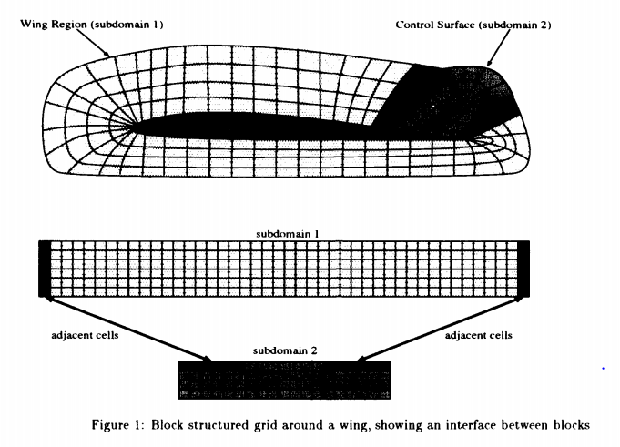
How the area around an aircraft wing has been modeled with a multiblock grid:

Slide 7
Runtime Support
In this section I present the details of the runtime support library that we have designed for parallelizing multiblock and multigrid codes on distributed memory machines. We discuss the nature of computation and communication in multiblock and multigrid codes and also describe how the library primitives facilitate parallelization of these applications. The set of runtime routines that we have developed is called the Multiblock Parti library. In summary, these primitives allow an application programmer or a compiler to "* Lay out distributed data in a flexible way, to enable good load balancing and minimize interprocessor communication, "* Give high level specifications for performing data movement, and "* Distribute the computation across the processors.

Slide 8
Multiblock and Multigrid Applications
For a typical multiblock application, the main body of the program consists of an outer sequential (time step) loop, and an inner parallel loop. The inner loop iterates over the blocks of the problem, after applying boundary conditions to all the blocks (including updating interfaces between blocks). Applying the boundary conditions involves interaction (communication) between the blocks. In the inner loop over the blocks, the computation in each block is typically sweeps over mesh in which each mesh-point interacts only with its nearby neighbors. Since in these applications, there are computational phases which involve interactions only within each block, communication overheads are reduced if each block is not divided across a large number of processors. So, blocks may have to be distributed onto subsets of processor space. Since the number of blocks is typically quite small (i.e. at most a few dozens), at least some of the blocks will have to be distributed across multiple processors. Partitioning of the parallel loop across the block is the source of the coarse-grained parallelism for the application. Furthermore, within each iteration of the inner loop fine-grained parallelism is available in the form of (large) parallel loops, iterating over the elements of the blocks.

Slide 9
Compiler Optimizations
Now we study the effect of the compiler optimizations. Version I is a compiler parallelized version in which the library does not save any schedules. This version performs badly because of the high cost of rebuilding the schedules for every iteration. Version II is the compiler parallelized version in which the library saves schedules. This results in a major gain in performance. We now discuss some optimizations which are not implemented in the current compiler. We studied the effect of these optimizations by modifying the compiler generated code by hand. Version III represents the case where the compiler performs sophisticated interprocedural analysis to reuse the schedules during successive time steps. Version III performs better than version II, in which the schedules are reused within the library, but the difference is not large. In the compiler parallelized version, runtime calls are made to the functions for adjusting loop bounds for each forall loop on each time step. The hand parallelized version can store the loop bounds computed during the first time step, for subsequent reuse. Additionally, a procedure may contain several loops involving the same array on the left hand side that have the same loop bounds. Our compiler generates separate runtime calls for adjusting loop bounds for each such loop. Such optimizations will be implemented in a future version of the compiler

Slide 10
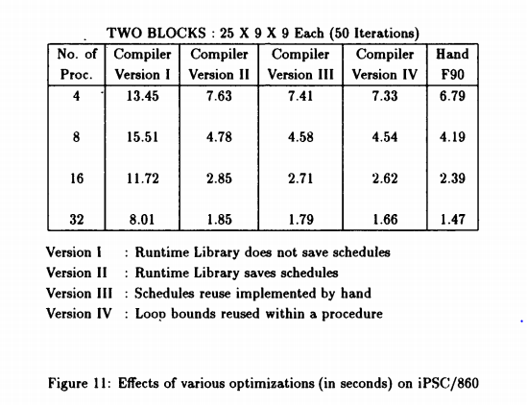

Slide 11
Effect of Data Distributions
One of the features of our runtime library is the ability to map arrays (or templates) to subsets of the processor space. In the current definition of HPF (and hence in HPF compilers), this is not possible. In block structured codes, this feature allows us to keep the communication overheads low while maintaining the load balance. To study the benefit of this feature, we experimented with the multigrid template described above for two block case. We ran the parallelized code, once distributing both the blocks over the entire processor space and then distributing each block over disjoint processor spaces. The results on Intel iPSC/860, shown in the Figure 12, show that the latter scheme improves the performance by nearly 10 to 25%. Since there is no difference in the net computation performed at each Processor in either of the the two cases, this difference comes because of the increased amount of communication required when each block is distributed across the entire processor space. Mapping a block over a large number of processors increases communication arising from near neighbor interactions during the regular computation within blocks. Note that a 10 to 25% degradation in performance occurs when there are only two blocks. We expect that with a larger number of blocks, the difference in the performance would be much more severe.

Slide 12
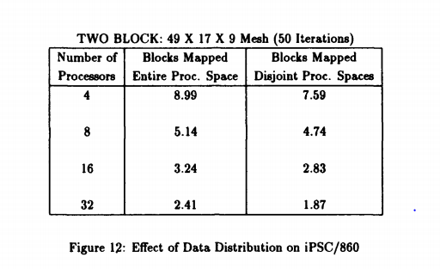

Slide 13
Conclusions
To reliably and portably program distributed memory parallel machines , it is important to have both a machine independent language and runtime support for optimizing communication. High Performance Fortran and its variants have emerged as the most likely candidates for machine independent parallel programming on distributed memory machines. One class of scientific and engineering applications involves structured grids or meshes. These meshes may be nested (as in multigrid codes) or may be irregularly coupled (called multiblock codes or Irregularly Coupled Regular Meshes). Multiblock and multigrid codes form a significant part of scientific and engineering applications.

